Slide 1
/Nithya/English/school

Slide 2
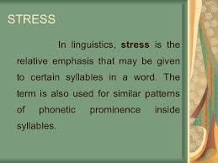

Slide 4
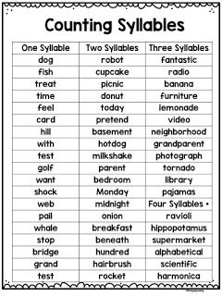
/Nithya/English/school

Slide 5
/Nithya/English/school

Slide 7
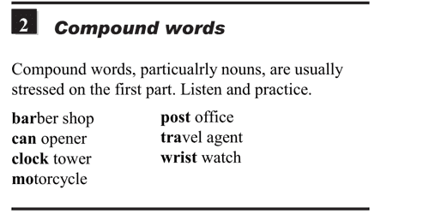

Slide 9
GOEBBELS

Slide 12
REFERENCES & THANKING SLIDE

